Slide 1
GOOGLE APP STORE DATA ANALYSIS
By: Rohan Palkar

Slide 2
Problem Statement
Technology is an increasing need nowadays and used everywhere. One of the features of Technology is android. Which we all use in our daily life. Android is a mobile operating system based on a modified version of the Linux kernel and other open-source software, designed primarily for touchscreen mobile devices such as smartphones and tablets.
29/01/2023
TITLE: GOOGLE APP STORE DATA ANALYSIS

Slide 3

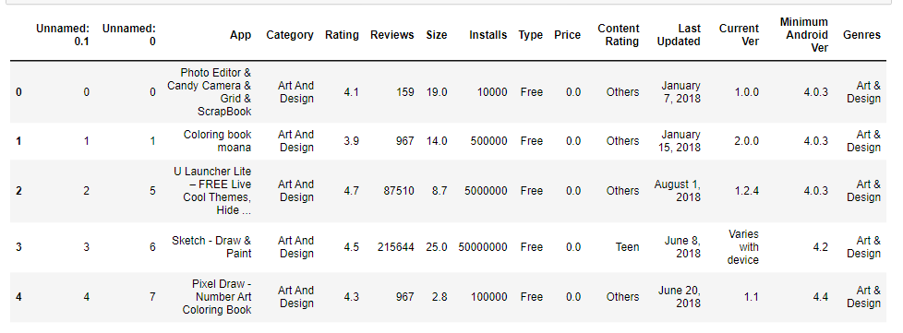

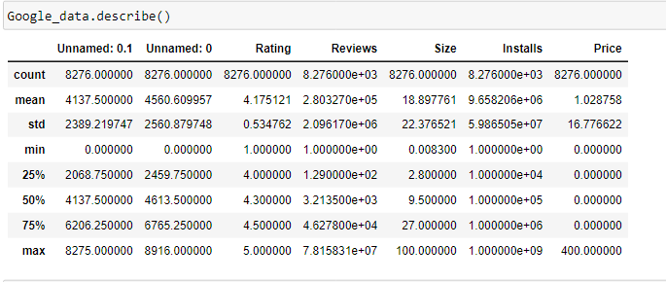
Project Work
29/01/2023
TITLE: GOOGLE APP STORE DATA ANALYSIS

Slide 4
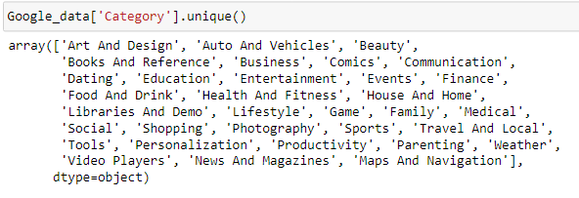
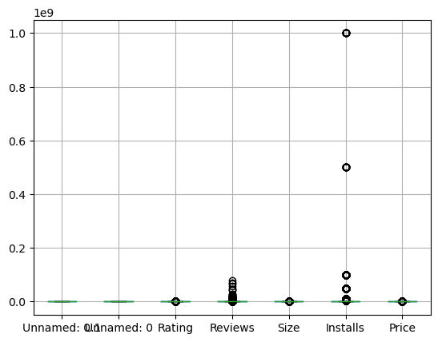
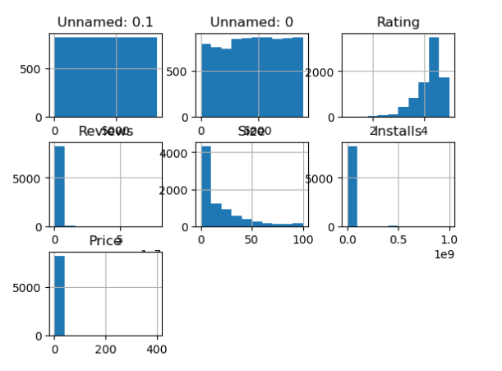
29/01/2023
TITLE: GOOGLE APP STORE DATA ANALYSIS

Slide 5
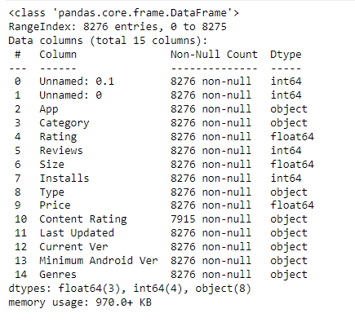
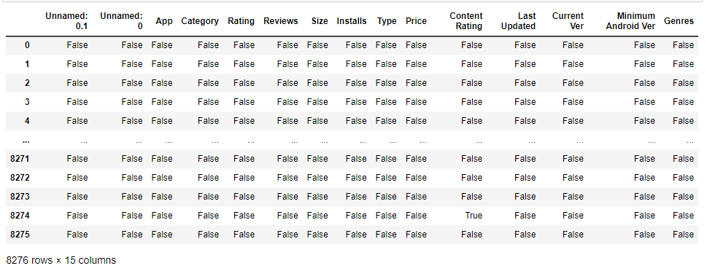
29/01/2023
TITLE: GOOGLE APP STORE DATA ANALYSIS

Slide 6
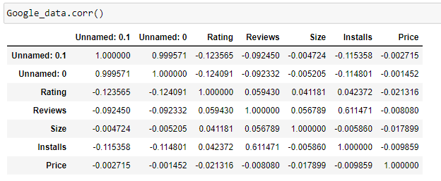
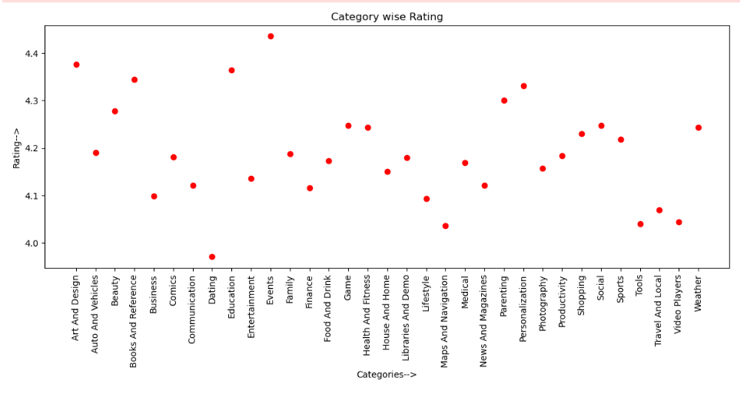
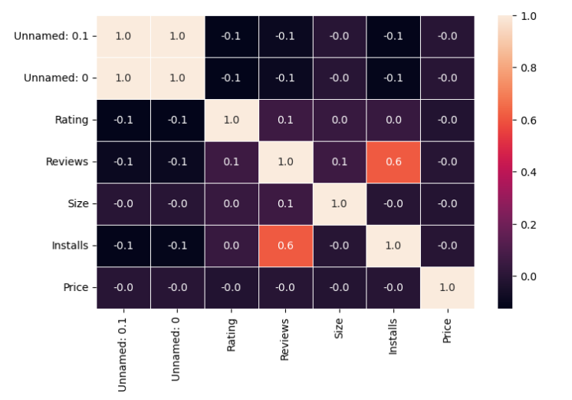
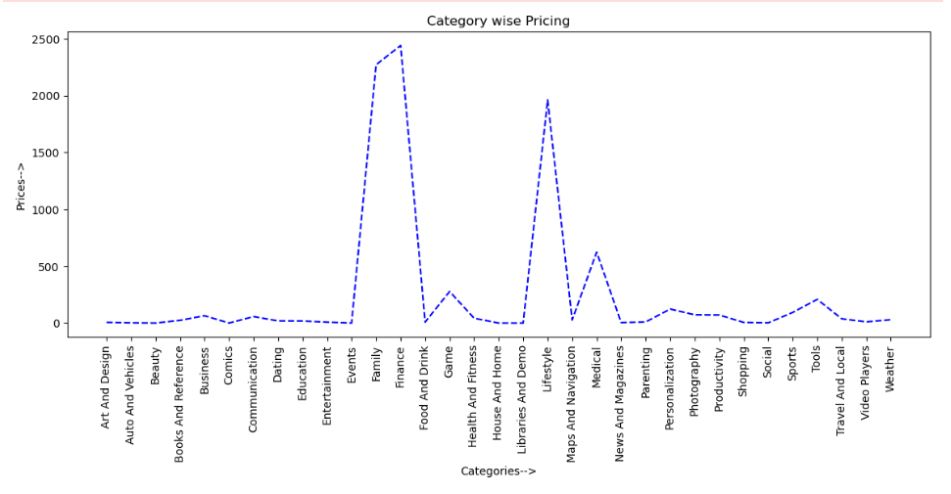
Correlation map
29/01/2023
TITLE: GOOGLE APP STORE DATA ANALYSIS

Slide 7
Thank You

